Slide 1
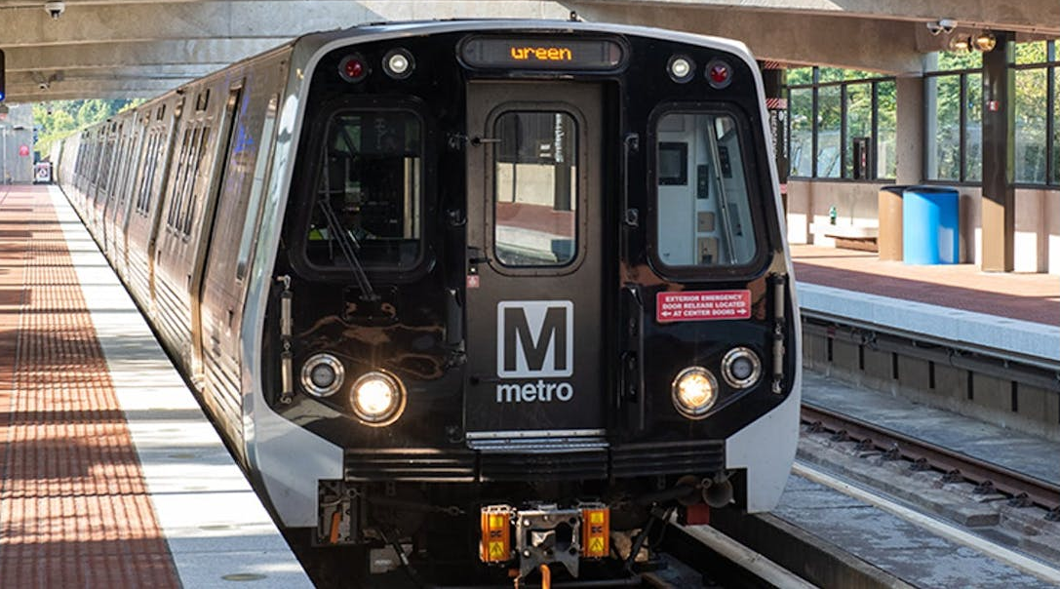
DC WMATA Metro Ridership Analysis
1
IC25035: Blen Bekele, Sohamm Rajput, Aravind A M, Seniah Zachariah

Slide 2
Overview
2
01 02
Problem Area of Focus
03 04
Data Analysis
and Findings
Solutions

Slide 3
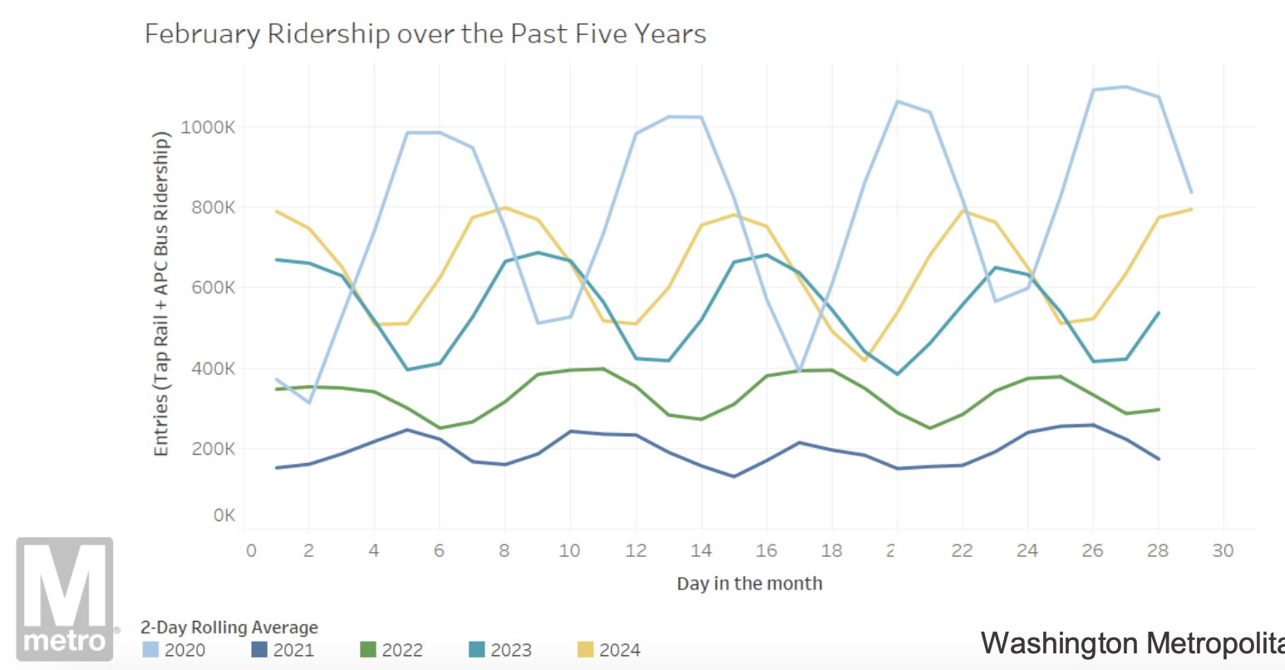
Problem
3
How Can We Get Metro Ridership Back To Pre-COVID Levels?
Metro Ridership Snapshot - February 2024 - (WMATA, 2024)
Feb 2020:
Approx. 1000k entries
Feb 2024:
Approx. 700k entries

Slide 4
Area of Focus
4
Fare Evasion
Problem: WMATA “conservatively estimates more than $40 million in revenue was lost in FY22 due to fare evasion on Metrorail.”
Effect on Metrorail Ridership: Loss of potential funding for overall metro improvements, which could have led to increased ridership
Notes:
"What factors contribute to non-tappers, and should the metro system address them?"

Slide 5
5
Questions
What are the trends in non-tapping behavior from 2020 to 2024?
What are the possible underlying reasons at stations with higher non-tapping rates?
Notes:
To help fix this problem we decided to focus on two areas to improve on
Fare Evasion Background -> Loss of revenue to fare evasion directly impacts revenue, service offering and delivery, system maintenance, and operational decisions
Federal Worker Schedules

Slide 6
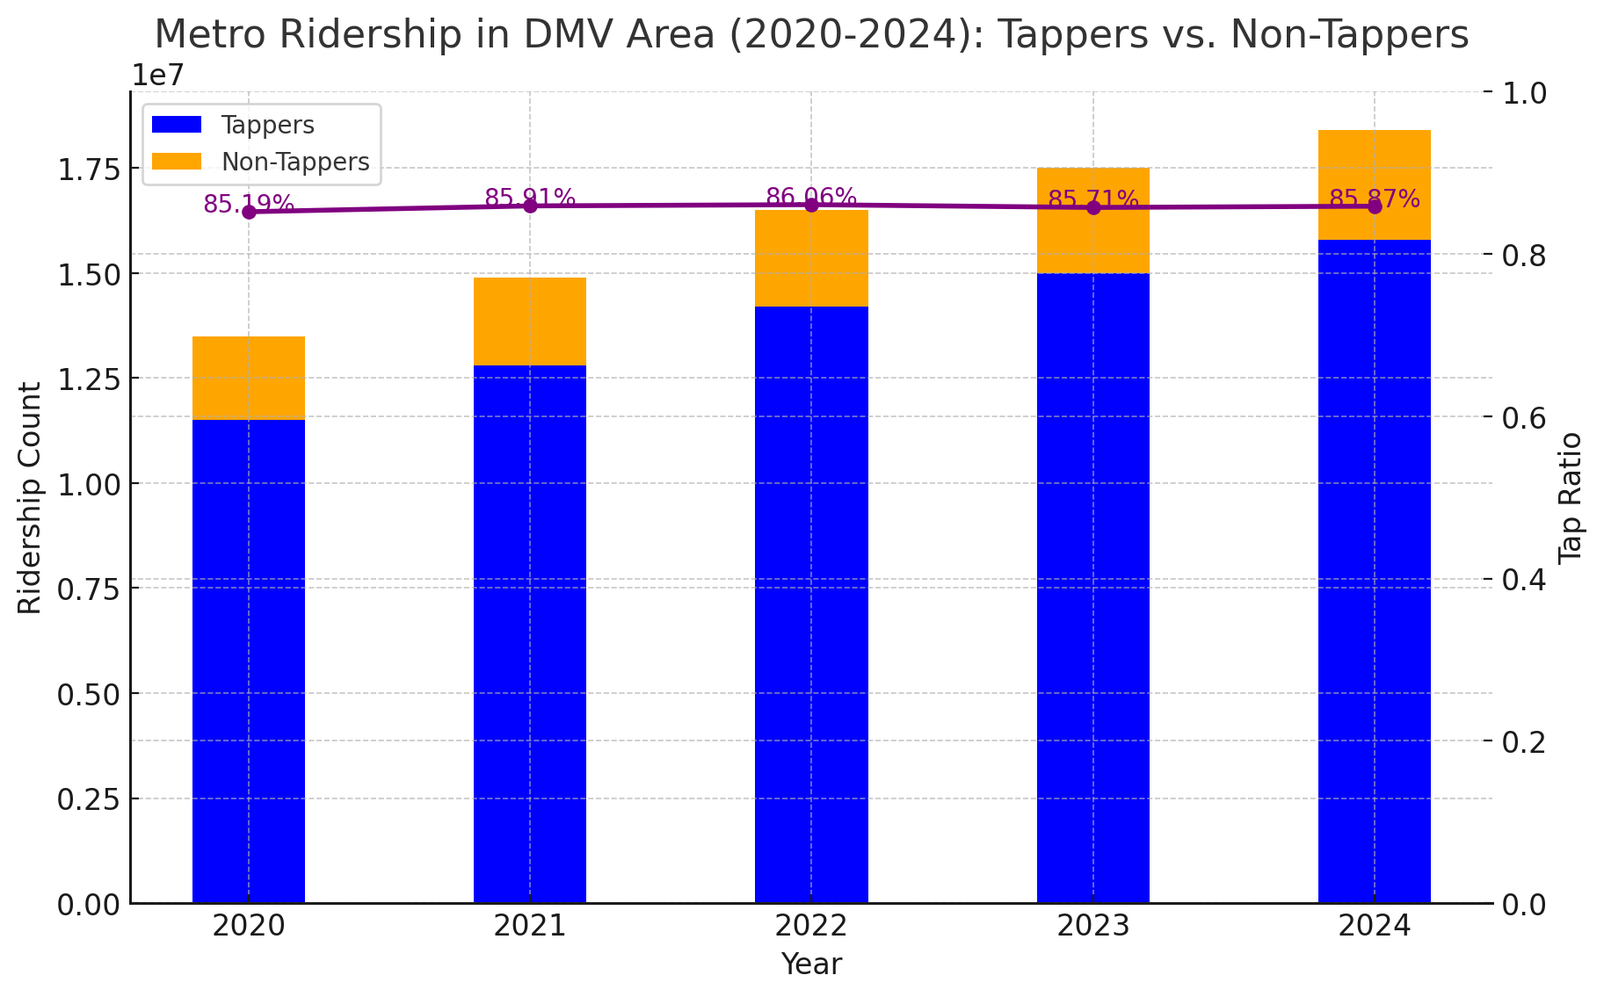
6
Visualization and Findings
The number of Non-Tappers has increased by 30% (2M in 2020 → 2.6M in 2024), maintaining a consistent share of total ridership.
Tap Ratio has remained stable at 85-86%, meaning roughly 14-15% of riders annually do not tap in. This suggests a systematic trend rather than random fare evasion cases.

Slide 7
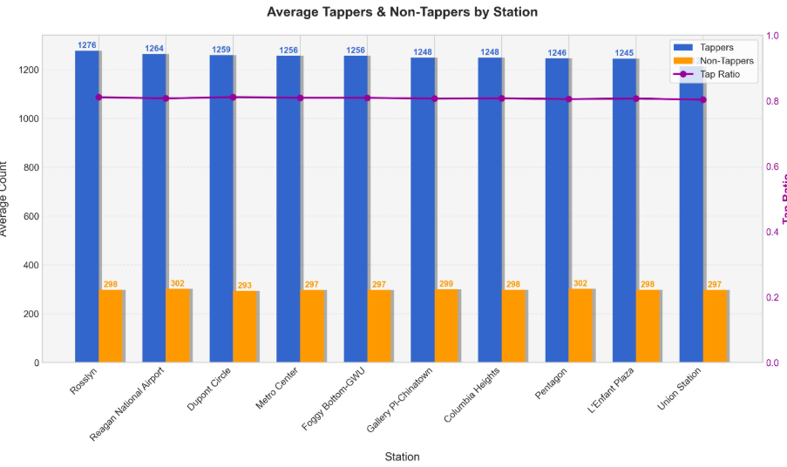
7
Visualization and Findings

Slide 8
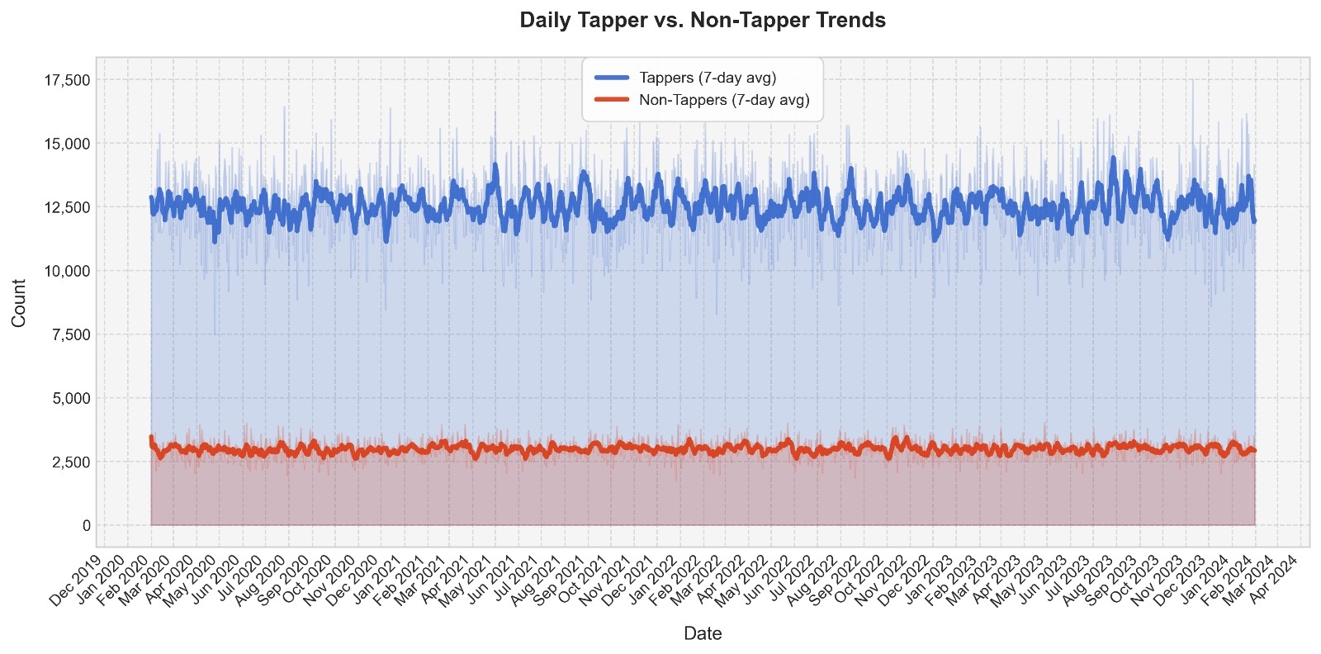
8
Visualization and Findings
Tappers consistently dominate ridership, showing strong daily and weekly fluctuations.
Non Tappers remain relatively stable, averaging about 2500 daily riders with minimal seasonal variation, suggesting a systemic rider category rather than occasional fare evaders.
Daily Tappers count vary significantly ranging between 10,000 to 15,000 riders

Slide 9
9
Tappers vs. Non-Tappers Data Analysis
Tappers significantly outnumber non-tappers across all analyzed stations.
Tap Ratio (Purple Line) remains relatively stable, suggesting that non-tappers consistently represent a small but notable percentage of metro users.
Tappers follow a highly fluctuating but consistent trend, showing daily and weekly variations in metro usage.
Non-tappers remain relatively stable over time, with minimal fluctuations—this suggests a constant underlying factor contributing to non-tapper behavior.
Notes:
"What factors contribute to non-tappers, and should the metro system address them?"

Slide 10
Proposed Solutions
10
Automated Alerts: Install motion detection software onto fare gates to send notifications to law enforcement officers when evasion is detected
Enhancing Security: Using Surveillance Footage to Track Repeat Offenders
Overall Goal:
Reduce fare evasion rates and increase revenue for Metrorail to fund necessary improvements to boost ridership

Slide 11
Area of Focus
4
Federal Workers
Problem: WMATA faces ridership fluctuations and revenue instability due to federal telework policies.
Effect on Metrorail Ridership: Loss of potential funding for overall metro improvements, which could have led to increased ridership
Notes:
"What factors contribute to non-tappers, and should the metro system address them?"

Slide 12
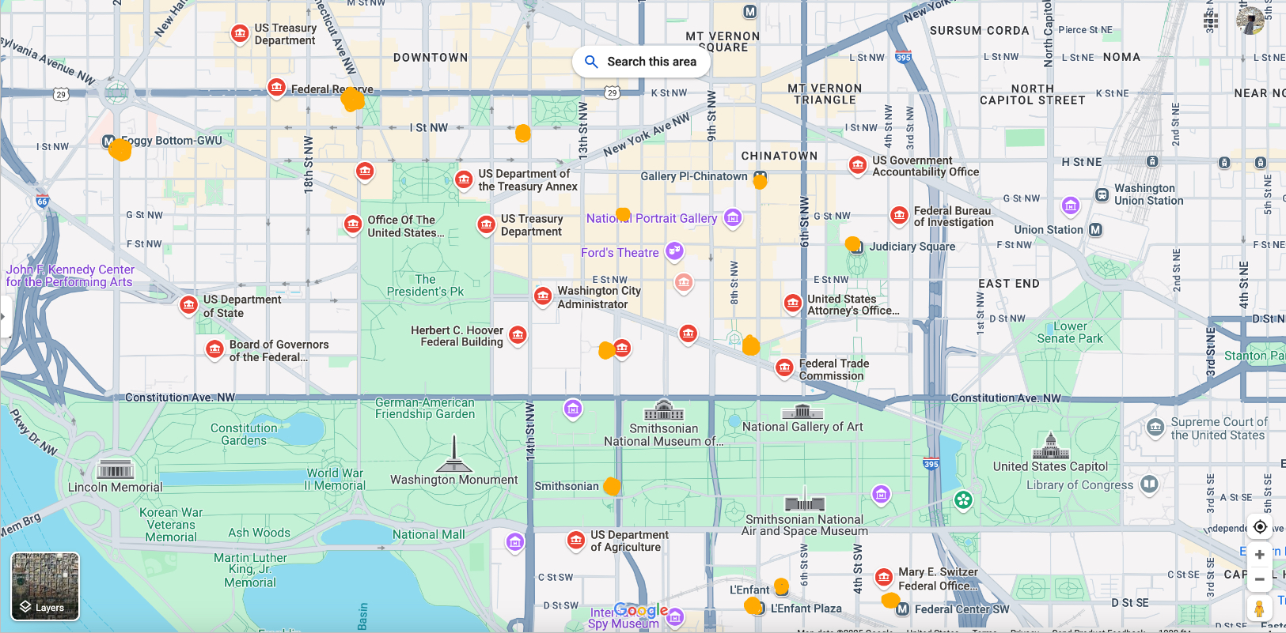
Map

Slide 13
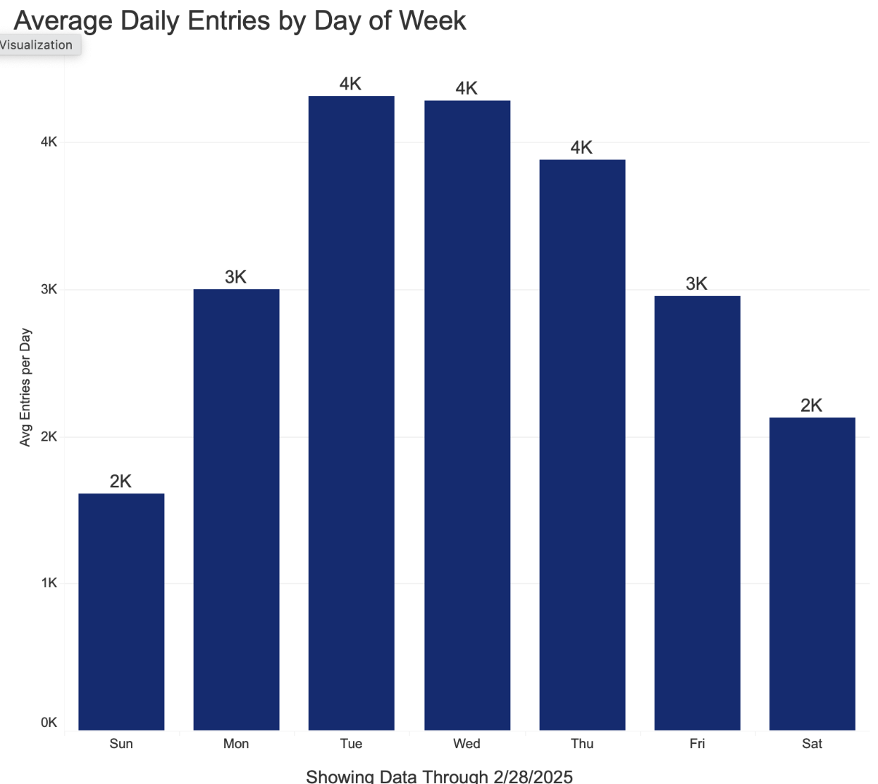
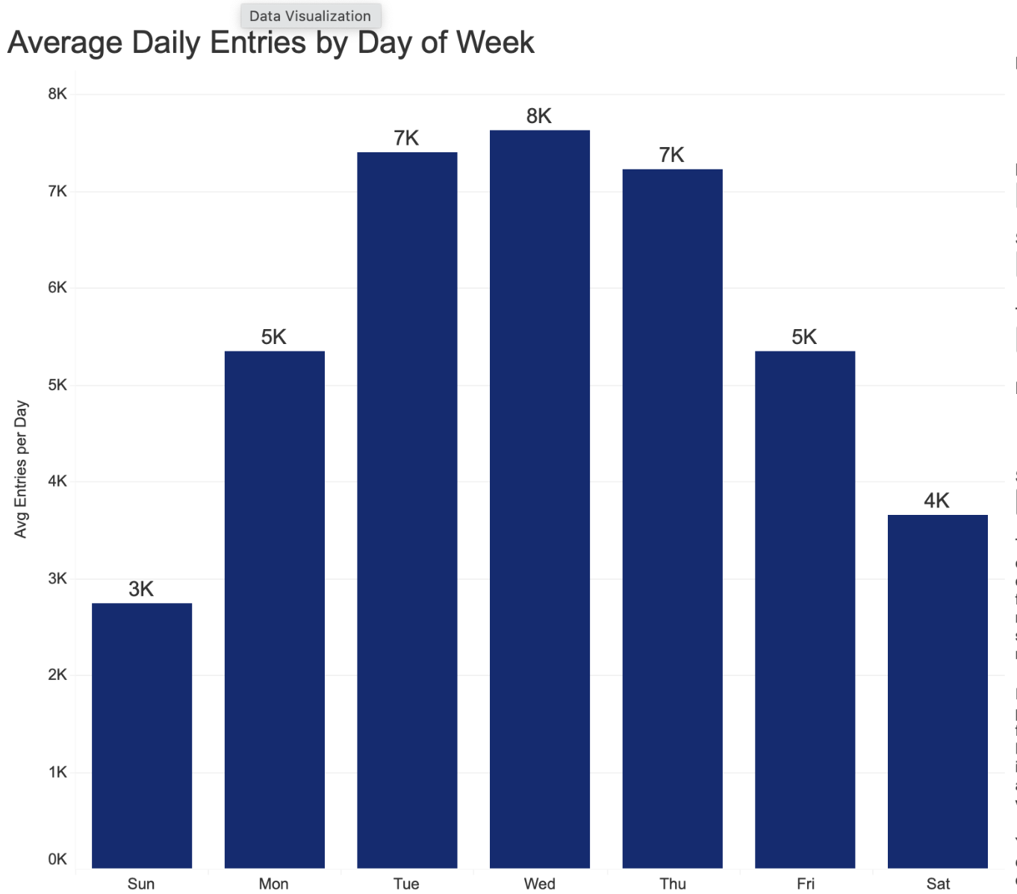
Federal workers ridership trends
10
Popular telework days: Mondays and Fridays
Federal Triangle Station
Mcpherson Station

Slide 14
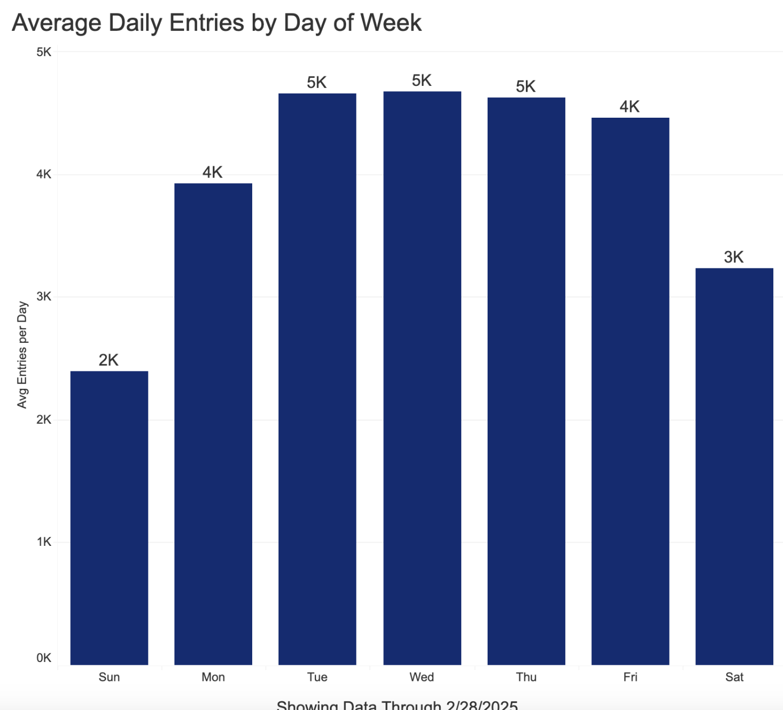
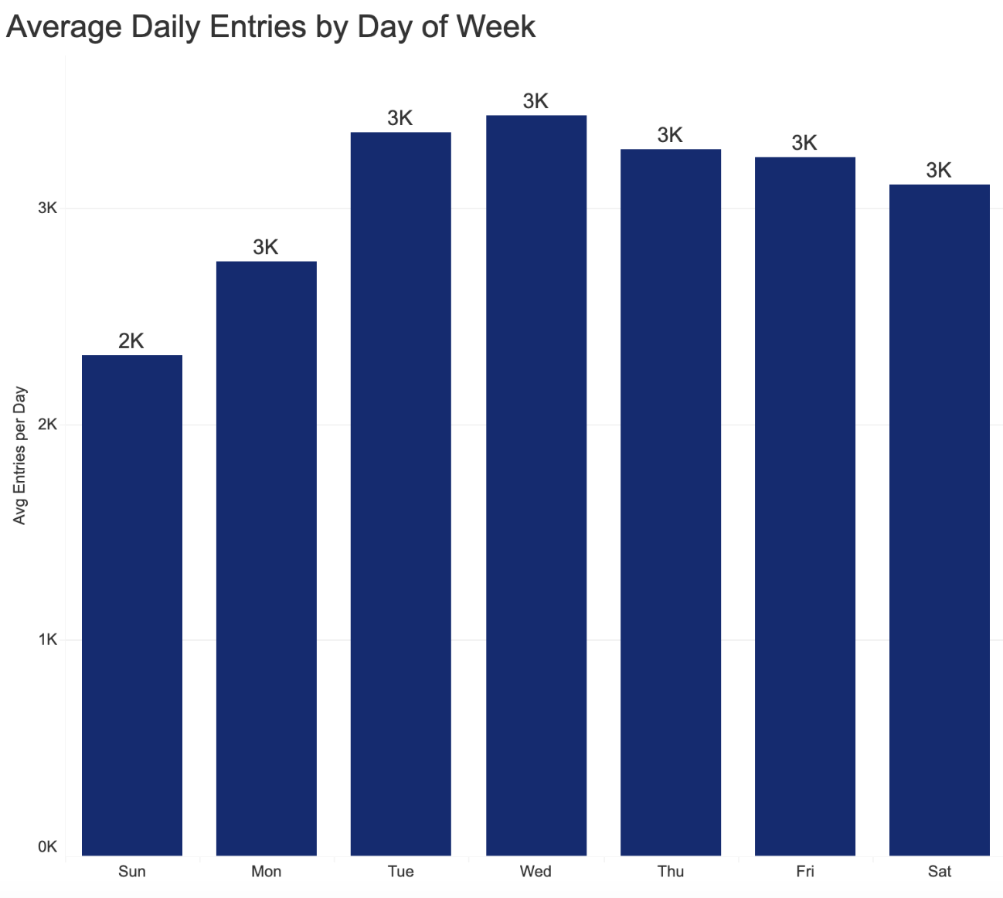
Comparison chart
10
Mt Vernon Square
Rhode Island Ave Station

Slide 15
9
Federal Workers Data Analysis
Metrorail ridership data consistently shows lower entries on Mondays and Fridays, indicating common telework days among federal employees.
Monday ridership is approximately 16.5% lower on average compared to Tuesday, Wednesday, and Thursday.
Friday ridership is reduced by approximately 10% compared to Tuesday, Wednesday, and Thursday.
Mid-week days (Tuesday–Thursday) exhibit significantly higher ridership, reflecting in-office attendance patterns.
Notes:
"What factors contribute to non-tappers, and should the metro system address them?"

Slide 16
Proposed Solutions
10
Introduce flexible fare passes targeting hybrid teleworkers
Provide incentives for federal workers commuting mid-week
Overall Goal:
Increase Ridership daily commuters on Monday and Friday

Slide 17
10
Thank you!

Slide 18
Thank you

Slide 19
11
References
“Remember to Pay Your Fare before Riding.” WMATA, www.wmata.com/fares/paythefare.cfm. Accessed 6 Mar. 2025.
Metro Ridership Snapshot - February 2024, www.wmata.com/initiatives/ridership-portal/upload/February-2024-Ridership-Snapshot.pdf. Accessed 7 Mar. 2025.
Dot,www.transit.dot.gov/sites/fta.dot.gov/files/2024-08/FTA-Report-0268-Effects-of-the-COVID-19-Pandemic-on-Transit-Ridership-and-Accessibility.pdf. Accessed 7 Mar. 2025
2024 status of Telework in the federal government. (2024). Retrieved from https://www.opm.gov/telework/history-legislation-reports/status-of-telework-in-the-federal-government-2024.pdf

